Slide 1
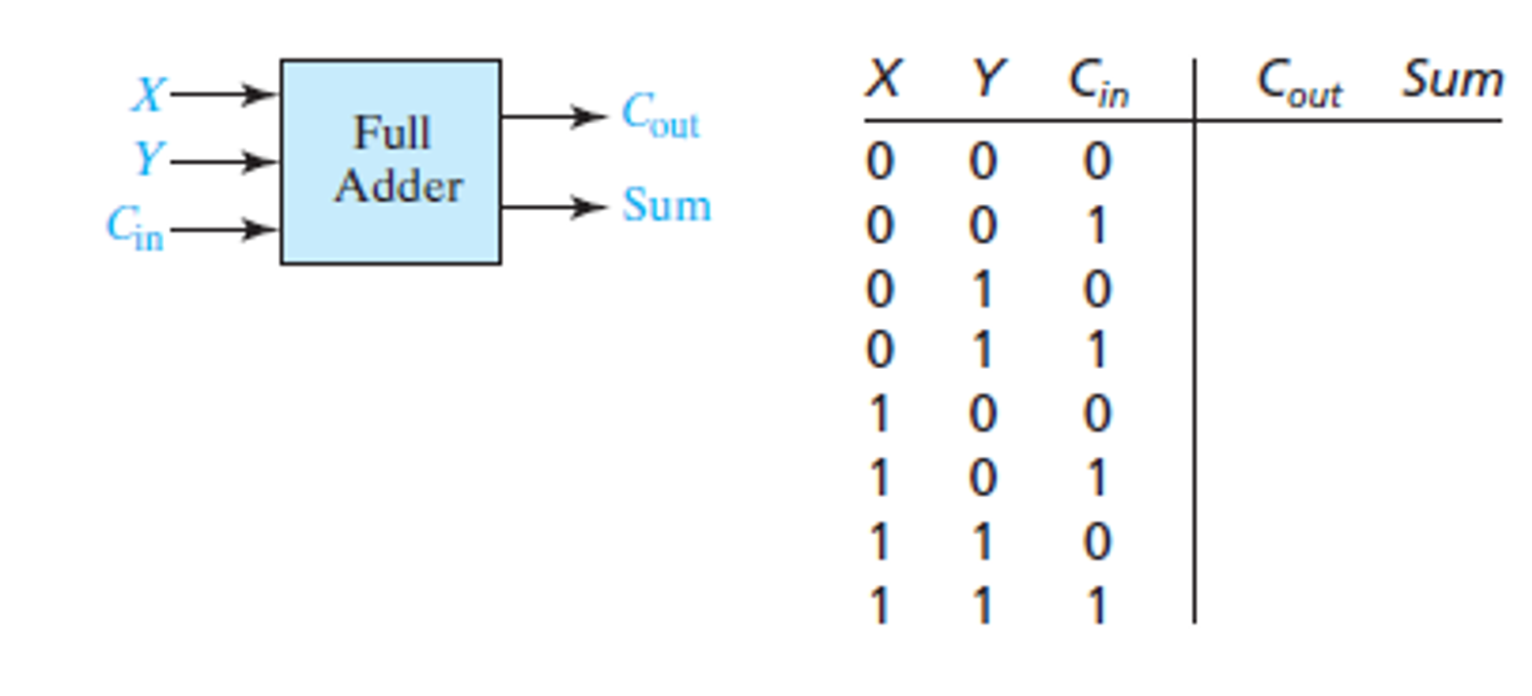

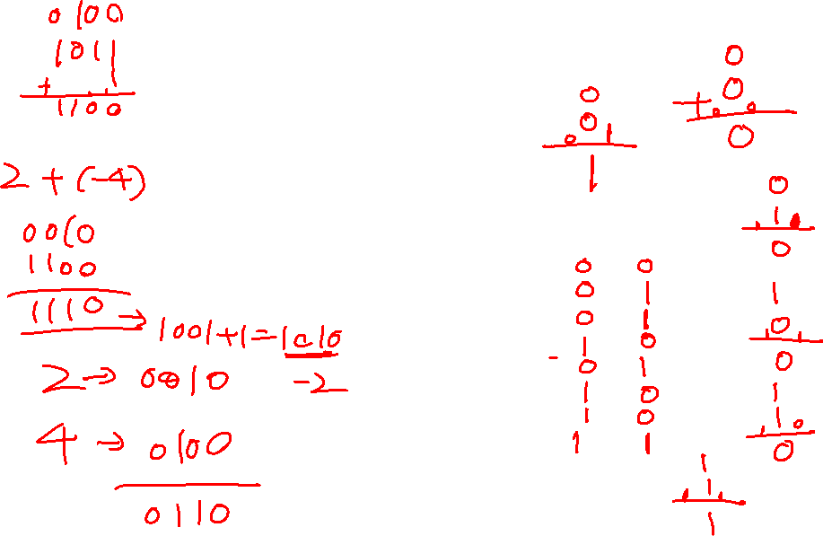
Lab 12. 4 bits adder
Full Adder Truth Table:

Slide 2
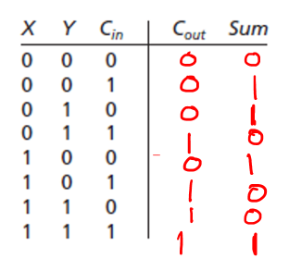
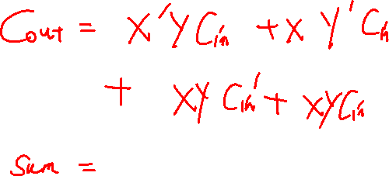
Design of Binary Adders
Logic Equations for Full Adder:
After complete the Boolean expression, show it to me. If it’s correct, I’ll let
you know the result after simplification, and then you use the simplified result
to create the subsystem!

Slide 3
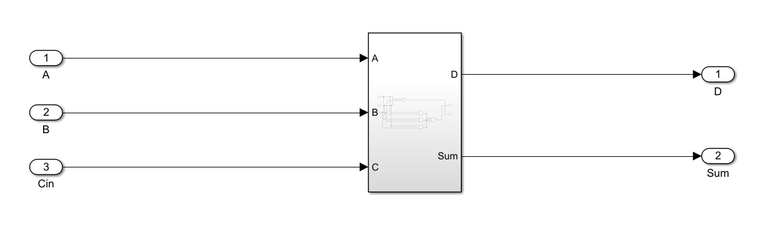
Design of Binary Adders
Create the subsystem in Simulink:

Slide 4
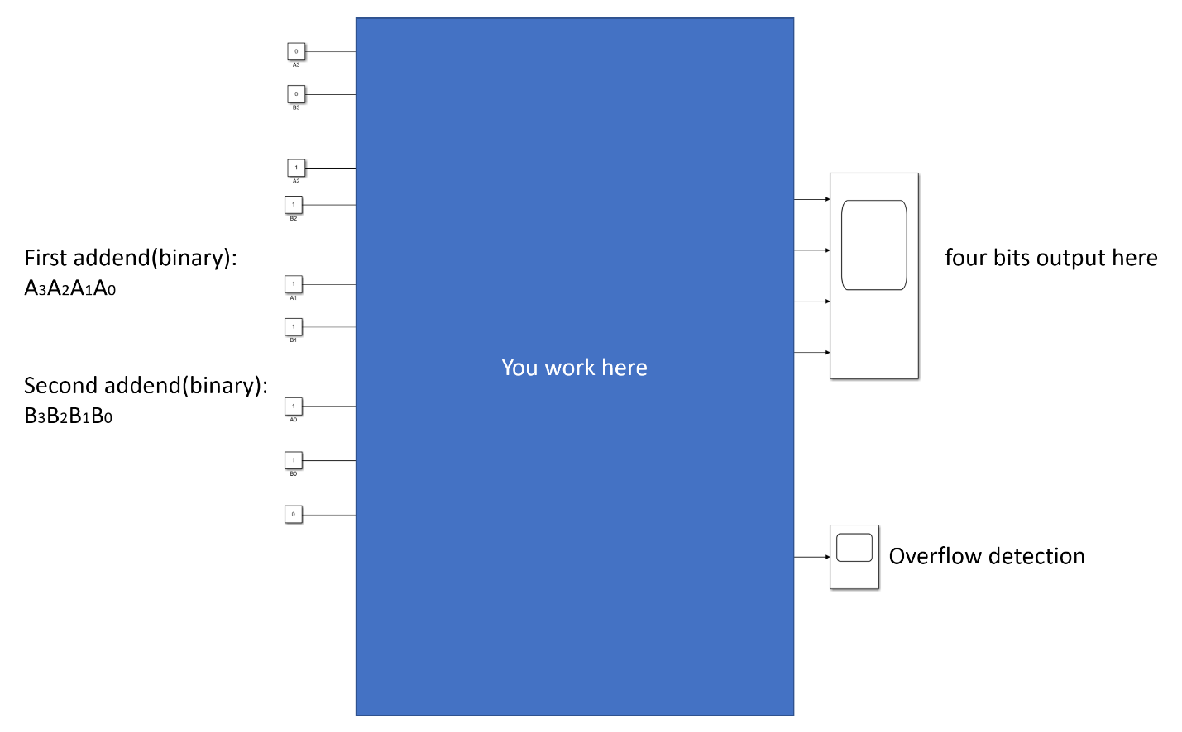
4 bits Adder:
You should have 9 bits of inputs:
4 bits for the first addend
4 bits for the second addend
1 bit, which is always 0, and used as the carry-in for the LSB.
For the output, you have two scopes (one is showing the result, one is used for overflow detection).
4 subsystems previously created needed!

Slide 5
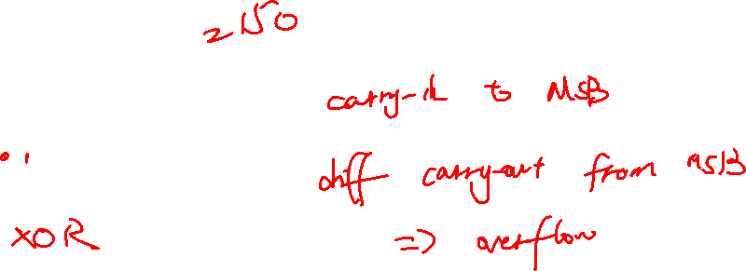
Overflow recap
Overflow occurs if (n + 1) bits are required to contain the result from an n-bit addition or subtraction
Example: 8-bits can represent values between -128 to +127.
Calculate 70 + 80:
0 1 0 0 0 1 1 0
+ 0 1 0 1 0 0 0 0
1 0 0 1 0 1 1 0

Slide 6
Requirement
1. modify the inputs for A3A2A1A0 and B3B2B1B0 to calculate 6+(-3). Take the screenshot of the output scopes(overflow detection+result). Please use 2's complement to denote the negative number.
2. modify the inputs for A3A2A1A0 and B3B2B1B0 to calculate 7+7. Take the screenshot of the output scopes(overflow detection+result).
Show the result to me or put all the screenshots in a word file or PDF and submit it.

